Slide 1
Admission Information
Liliane Gutte & Nina Jacob
Exchange Student Admission Information
Nina Jacob & Lilian Henschke
International Office ￭ 13.07.2023

Slide 2
Contacts
Semester Dates
Place of Study
Accommodation
Orientation
Visa Application
Health Insurance
Enrolment
Semester Contribution
Town Registration and Residence Permit
Student ID & Semester Ticket
Q&A Session

Slide 3
Contacts
Administration/ General:
Central International Office: exchange.incoming@uni-due.de
Academic
Faculty Contacts: see page 4
Accommodation
Studierendenwerk: https://www.stw-edu.de/en/accommodation/onlineapplication
Ask a Student
ISAAC* and Buddy Programme:
https://www.uni-due.de/international/tsc
Email: info@isaac-due.de
Instagram: https://www.instagram.com/isaac.unidue/

Slide 4
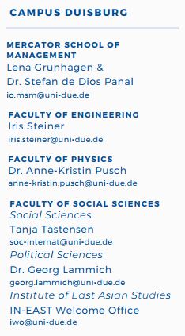
Faculty contacts

Slide 5
Important Dates
Winter Semester 2025/26: 01.10.2025 – 31.03.2026
Lecture Period: 13.10.2025 – 06.02.2026
Christmas Holidays 20.12.2025 – 04.01.2026
Orientation: 06.10.2025 – 10.10.2025
Moving Date Student Residences: 06.10.2025
Re-registration Period: 02.01.2026 – 20.03.2026 Summer Semester 2026: 01.04.2026 – 30.09. 2026
Lecture Period: 13.04.2026- 24.07.2026
Considerations:
When do lectures start?
When do I get the Payment of Erasmus grant from home university?
When can I move into student accommodation?
→ Ask your academic supervisor/ faculty coordinator about typical exam dates

Slide 6
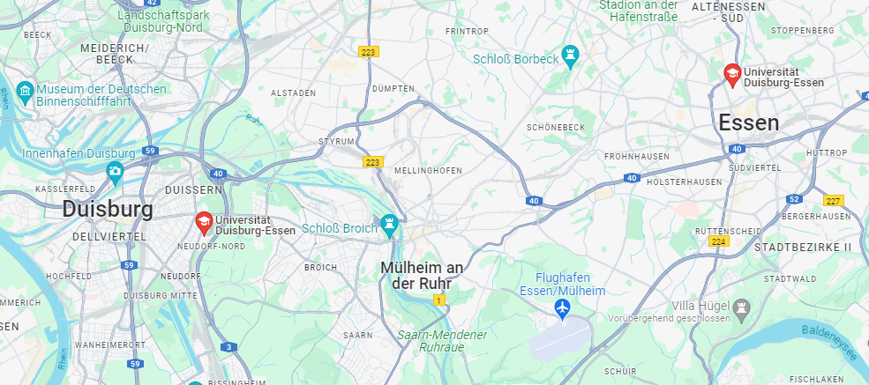
Where will I study?
Campus Essen
Biology
Campus Duisburg
Mercator School of Management
Uni Klinikum Essen
Medicine
Chemistry
Engineering (Civil Engineering)
Humanities
Economics and Business Administration
Educational Sciences
Mathematics
Physics
Social Sciences
Engineering
Computer Science
Computer Science

Slide 7
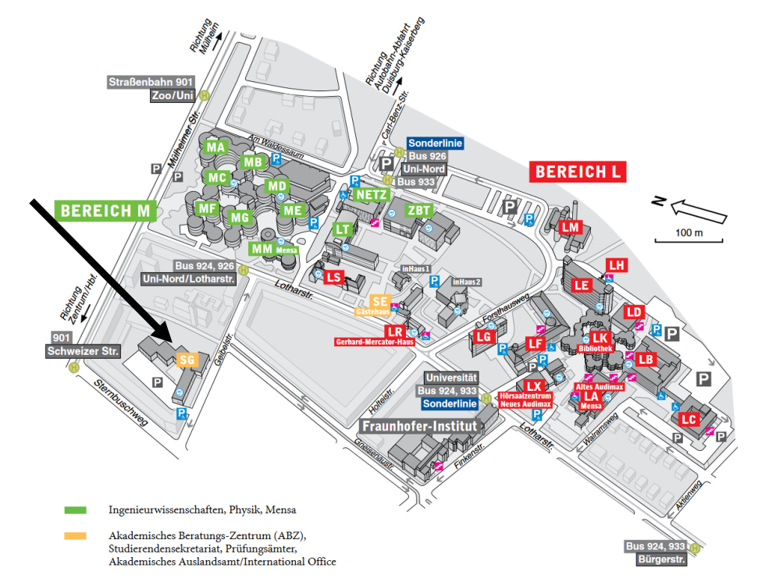
Orientation – Campus Duisburg
You can find us here: International Office SG 027

Slide 8
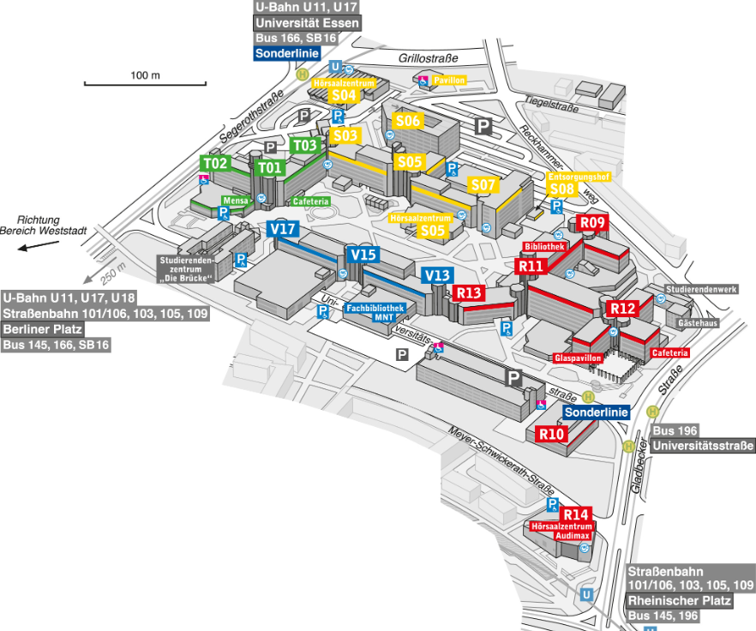
Orientation – Campus Essen

Slide 9
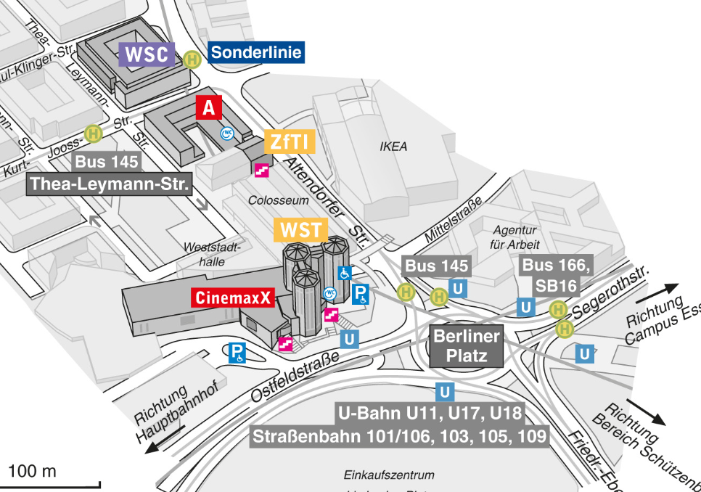
Orientation – Campus Essen IO
You can find us here: International Office WST-C 06.05

Slide 10
Orientation – Adresses, Maps and Directions
Maps and Directions:
https://www.uni-due.de/en/university_addresses.shtml
Bus services between the Campuses:
https://www.uni-due.de/verwaltung/busservice.php
International Front Office Duisburg:
SG Building, Room 027, Geibelstr. 41, 47057 Duisburg
International Front Office Essen:
“Weststadttürme” Building, Room WST-C 06.05., Berliner Platz 6-8, 45127 Essen

Slide 11
Accommodation
The Studierendenwerk is the responsible organization for accommodation: It works separately from the UDE!
Five dormitories in Essen, Duisburg and Mülheim → Allocation of the rooms is done by the dormitory administration
All rooms are already furnished
Rental agreements for the entire semester only
Rooms allocated on first come, first served basis. There is no guarantee to get a room!!!
https://www.stw-edu.de/en/
https://www.stw-edu.de/en/accommodation/onlineapplication

Slide 12
Accommodation – Application Process
1. Keep your Admission Letter ready
2. Fill out the online application: https://www.stw-edu.de/en/accommodation/onlineapplication
3. Pay deposit (approx. 850 €) to accept room offer from Studierendenwerk Please notice, that you might not be allocated your preferred room, due to high demand
4. Sign your rental contract → Please note that changes and cancellations are not usually possible after you sign the contract
https://www.stw-edu.de/en/
For help please send an e-mail to:
wohnen@stw-edu.de
https://www.stw-edu.de/en/accommodation/for-applicants/accomodation-offer/semester-abroad/exchange

Slide 13
Accommodation – Further Options
Private Housing Market:
http://www.wg-gesucht.de/ http://www.immobilienscout24.de/de/finden/wohnen/index.jsp http://www.studenten-wohnung.de/ http://waz.immowelt.de/
Private Dorms in Duisburg:
https://www.studentenwohnheim-duisburg.de/ https://www.kolping-jugendwohnen.de/haus/duisburg/
Private Dorms in Essen: https://www.smartments-student.de/standorte/essen-natorpstrasse
More information and Important terms when you are looking for an apartment or room: http://www.uni-due.de/scies/accommodation.shtml#glossary
http://www.uni-due.de/imperia/md/content/diversity/illu_wohnheimwoerterbuch.pdf

Slide 14
Visa Application
EU nationals do not need to apply for a visa.
Non-EU nationals should use this list of countries to check if you need to apply for a visa before entering Germany. Please note: Applications can take many weeks so apply early.
Non-EU nationals who already have a residence permit for an EU country should send a copy of this permit to the International Office as soon as possible: exchange.incoming@uni-due.de

Slide 15
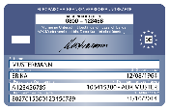
Health Insurance
All students need to provide proof of sufficient health insurance which is valid for the entire semester and a Digital Confirmation Notification(M10) by any German statutory health insurance provider!
You cannot complete enrolment without valid health insurance AND the corresponding Digital Notification!
European Health Insurance Card (EHIC)
AT11
Private/German health insurance
Request a confirmation M10 from a German health insurance provider („Krankenkasse“). You may be asked for our code: H0000277

Slide 16
Health Insurance – IMPORTANT!
Send a copy (both sides) of your EHIC/ AT11/ Private health insurance to a statutory health Insurance Provider
or
conclude an insurance contract with a German statutory health insurance company
Sends M10 as confirmation of Insurance
AOK Rheinland/Hamburg: Ms. Heide Estacio
heide.estacio@rh.aok.de https://www.aok.de
Ask for M10
Techniker Krankenkasse: Ms. Birgit Görgen
birgit.goergen@tk.de
https://www.tk.de
As soon as UDE receive the confirmation, the enrollment can proceed
Barmer GEK: Mr. Michael Laing
michael.laing@barmer.de https://www.barmer.de
UDE sends a confirmation of enrolment to Krankenkasse
Please note:
These are only some of the possible health insurance providers and this is not a recommendation!
Feel free to contact any Krankenkasse of your choice.

Slide 17
Enrolment & Student Contribution Fee
We typically need 14 days to process your enrolment after we receive the digital confirmation, so please arrange the confirmation of your health insurance as soon as possible Deadline: August 15
We will contact you by the mid of September and send you an e-mail with the payment information and login data for your student account
All students need to pay a semester contribution (approx. 349,80 € per semester). This is only payable via bank transfer after you complete enrolment. It is not a tuition fee and ALL students (including Erasmus) have to pay.
With the contribution fee you will also receive a semester ticket for public transport in whole Germany

Slide 18
Town Registration – EU Nationals
Everybody in Germany has to register at the town they live in. Where you register and what documents you need will depend on your nationality, the length of your stay and where you live.
EU Nationals:
In order to register, you will need:
Passport or ID card
“Wohnungsgeberbestätigung”*
Essen:
Duisburg:
*if you live in the dorms, you have received the Wohnungsgeberbestätigung PDF in the email with your contract, otherwise you can download a copy here and ask your landlord to fill it out
You can go to the closest Bürgeramt to register. Details here: Bürgeramt
Make an appointment at one of the Bürger-Service-Stations. Details here: Bürgerservice (Select Meldeangelegenheiten)

Slide 19
Town Registration – Non-EU Nationals
If you have a visa that covers your entire stay, you do not need a residence permit. If you are not sure, ask the immigration office staff during your appointment. In any case, you must also do the town registration
Non-EU Nationals:
Essen: Use this link to apply for an appointment online. Under the bullet point " Onlinedienstleistungen" you will find the link "Terminvergabe Studierende" (Appointment allocation for students). Please note that it can sometimes take a while (up to 4 weeks) before you receive a reply.
Duisburg:
Make an appointment at one of the Bürger-Service-Stations. Details here: Bürgerservice (Select Meldeangelegenheiten)

Slide 20
Residence Permit – Non-EU Nationals
Please note that you only need a residence permit if your visa does not cover your entire stay! We strongly recommend that you apply for the visa in your home country. In general you will need the following documents for town registration and to apply for a residence permit:
Passport
Wohnungsgeberbestätigung*
a current biometric passport photo (not older than 6 months)
Proof of health insurance
Proof of finance
- blocked account,
- declaration of commitment (Verpflichtungserklärung) and/or
- scholarship
Valid** Studienbescheinigung
Fees of up to €113.00 (payable in cash or EC)
*if you live in the dorms, you have received the Wohnungsgeberbestätigung PDF in the email with your contract, otherwise you can download a copy here and ask your landlord to fill it out
**You must pay the semester contribution in order to download a new, valid Studienbescheinigung from the HISinOne portal

Slide 21
Semester Ticket
You can access your semester ticket via the myUDE smartphone app: myUDE - the Campus-App of the University Duisburg-Essen (uni-due.de).
Please note: The semester ticket is only valid after the start of the semester (01.04./01.10.)
The Semester Ticket corresponds to the “Deutschlandticket” and can be used on local public transport throughout Germany
Please always use the ticket with a photo ID
Please find more information on the following websites:
Semesterticket - Info Enrolment Office
Semesterticket - Info ASTA
DeutschlandTicket – VRR
Ask your local transportation company:
Duisburg: DVG – Duisburger Verkehrsgesellschaft
Essen: Ruhrbahn

Slide 22
Student ID Card
All students are issued a student identity card, which can be collected from the International Front Office at the respective campus.
The student identity card doubles as your library card and Mensa card with payment chip. You can use the identity card at the self-service stations (to print student certificates, make changes to your address, print bank transfer slips) and to use the washing machine at your student residence.
You do not need an ID card for Mensa (EC Card is possible, too) or public transportation!

Slide 23
Next Steps
July | You should begin your visa application (if applicable) You can apply for accommodation in student residences if you wish You should apply for an EHIC/AT11
August | You should send a copy of your health insurance documents to a German health insurance provider and request a confirmation (M10) for enrolment by 15.08.2025 A student tutor from the ISAAC will contact you and introduce themselves mid-August
September | A volunteer student Buddy will contact you and introduce themselves mid-September After enrolment, from September 18: If you are taking an IwiS language course, you need to take the online placement test and register for classes at the correct level (Start: September 18, 10 am ; Deadline: October 16 8 am → uni login required)
October | You should arrive on October 5 Take part in the Orientation activities (check the ISAACS social media and the Orientation Moodle for further details!) Classes start on Monday October 13 If you are living in student residences, the first moving in day possible is usually Thursday, October 6 (Contact the Studierendenwerk or your Hausmeister for further information) Send us a proof of your arrival (plane/ train ticket or similar documents) for your Arrival Certificate.

Slide 24
Q&A
Have a great start!
Questions?
Visit our website for more information or write us an email to
exchange.incoming@uni-due.de.
If you are looking for more information, we recommend these pages:
https://www.study-in-germany.de/en/ & https://www.daad.de/en/studying-in-germany/living-in-germany/

